Slide 1
Topic Modelling USING PLDA AND PLSA
180030571 - N.Janaki
GROUP -211
PROJECT GUIDE – DR.SASMITA PADHY (6488)

Slide 2
Contents
1. | INTRODUCTION
2. | ABSTRACT
3. | PLDA
4. | PLSA
5. | REFERENCES

Slide 3
INTRODUCTION Topic Modelling
Topic modeling is a method in natural language processing (NLP) used to train machine learning models.
The process of logically selecting words that belong to a certain topic from within a document.
Topic modeling provides great time and effort saving benefits.
The three most common techniques of topic modeling are :
Latent Semantic Analysis (LSA)
Probabilistic Latent Semantic Analysis (pLSA)
Latent Dirichlet Allocation (LDA)
Topic modeling is a powerful technique for unsupervised analysis of large document collections.
Topic models conceive latent topics in text using hidden random variables, and discover that structure with posterior inference.
Topic models have a wide range of applications like tag recommendation, text categorization, keyword extraction and similarity search in the broad fields of text mining, information retrieval, statistical language modeling.

Slide 4
Latent Dirichlet Allocation (LDA)
LDA is a process of topic model and is used to classify text in a document to a particular topic.
It builds a topic per document model and words per topic model, modeled as Dirichlet distributions.
The core concept is replaced by Dirichlet allocations where the distribution is sampled over a probability simplex.
The total desired number of topics is set as ‘k’ in the dimensional Dirichlet distribution.
The LDA model reads every document, assigns each word to one of the ‘k’ topics, and provides a representation of the words and documents for a given topic.
LDA is proven to deliver accurate results for topic modelling use cases.
LDA represents documents as mixtures of topics that spit out words with certain probabilities.

Slide 5
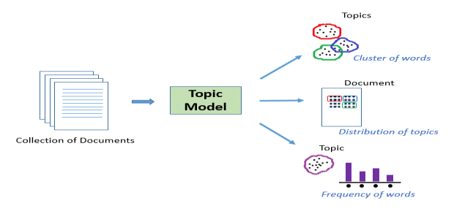
FLOW OF LDA

Slide 6
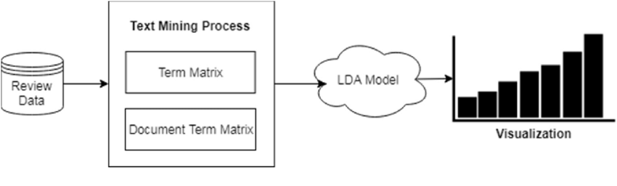
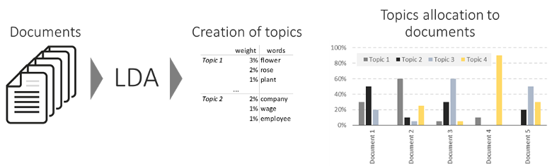
LDA REPRESENTATION

Slide 7
PLSA
Our goal is to assign these topics to documents.
One of the methods to perform this task is Probabilistic Latent Semantic Analysis (PLSA).
PLSA or Probabilistic Latent Semantic Analysis is a technique used to model information under a probabilistic framework. Latent because the topics are treated as latent or hidden variables
PLSA can be understood in two different ways.
1.Latent Variable Model
2.Matrix Factorization

Slide 8
The variables of PLSA
Documents: D={d1,d2,d3,…dN}, N is the number of documents.
Words: W={w1,w2,…wM}, M is the size of our vocabulary. wi denotes ith word in the vocabulary W.
Topics: Z={z1,z2,…zk} — Latent or hidden variables. The number k is a parameter specified by us.

Slide 9
Latent variable model
The way we associate z with (d,w) is that we describe a generative process where we choose a document, then a topic, then a word. Formally,
We select a document with a probability P(d)
For every word in this document dn, wi - Select a topic zi from a conditional distribution with a probability P(z|dn). - Select a word with a probability P(w|zi)

Slide 10
Matrix factorization model
An alternative way to represent PLSA is Matrix Factorization Model.
Consider a document-word matrix of dimensions N*M, where N is the number of documents and M is the size of the vocabulary.
The elements of the matrix are counts of the occurences of a word in a document. If a word wi occurs once in the document dj, then element (j,i) = 1.
This model is not very different from the Latent Variable Model. The three matrices can be interpreted as —
L contains the document probabilities P(d|z)
U is a diagonal matrix of the prior probabilities of the topics P(z)
R corresponds to the word probability P(w|z)

Slide 11
PLDA
LDA is a supervised dimensionality reduction technique. LDA is linear discriminant analysis
we need a model which is more flexible in finding the optimal direction of projections.
We use PLDA as they are not LDA is not optimal because LDA will project the images into a subspace obtained from training data.
We can generate class center using continuous non-linear functions even from single example of unseen class.
In hypothesis testing , we can compare two examples from previously unseen classes to determine whether they belong to same class.
Perform clustering of samples from unseen classes

Slide 12
Probabilistic LDA ?
Let x={x₁,x₂,…,xₙ} be the D-dimensional observations or data samples.
Probabilistic LDA or PLDA is a generative model which assumes that given data samples are generated from a distribution.
The choice of distribution from which data is assumed to be generated is based on two factors:
(1) It should represent different type of data
(2) Computation of parameters is simple and fast.
we need to represent each class with separate Gaussian distribution hence we can use Gaussian Mixture Model (GMM).

Slide 13
PLDA conclusion
PLDA is a generative model where we assume that the data samples X of a class are generated from a Gaussian distribution.
The mean of Gaussian represents the class variable y is generated from another Gaussian distribution called as prior.
We can perform clustering of examples into classes using PLDA scores between all pairs of examples from entire set of examples

Slide 14
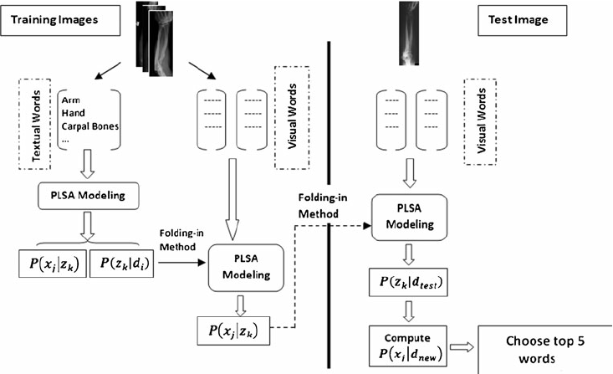
PLSA

Slide 15
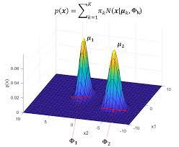
PLDA

Slide 16


